Slide 1

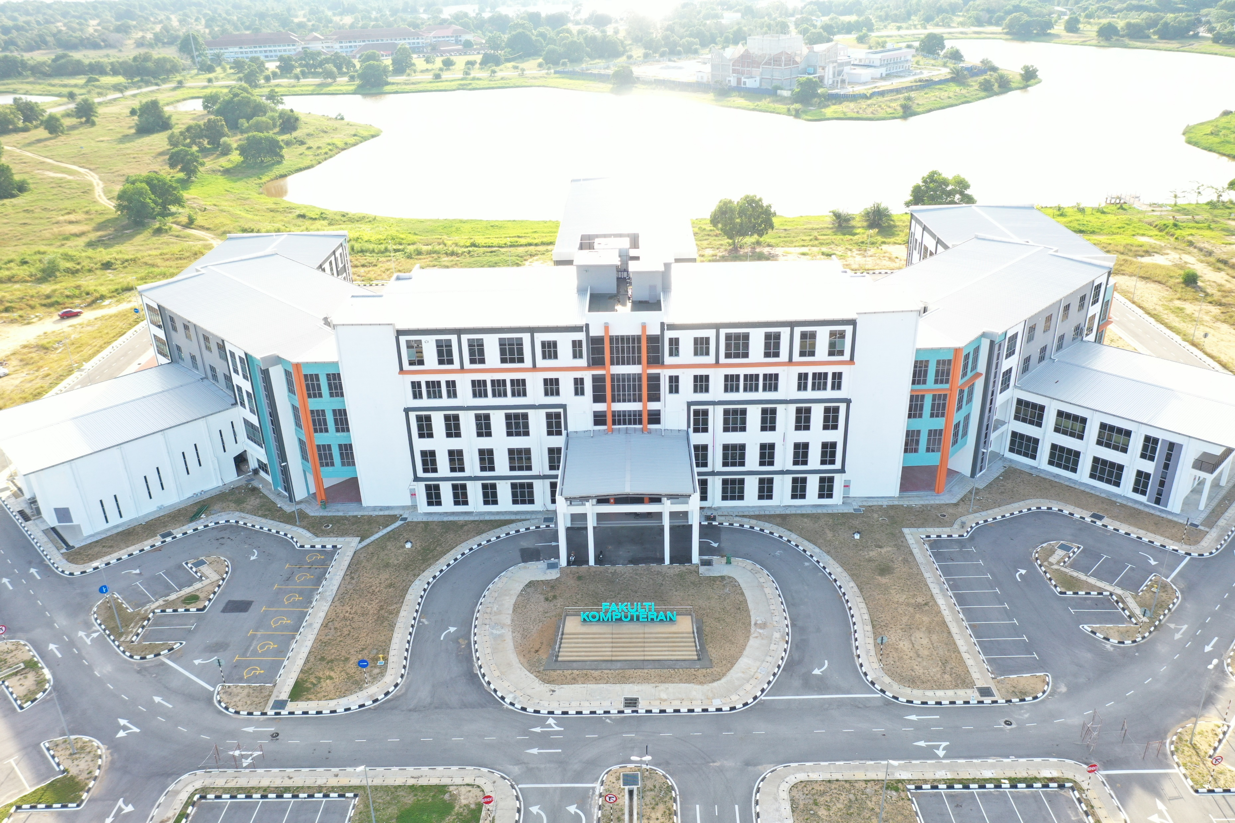





TUTORIAL
ARTIFICIAL INTELLIGENCE
Machine Learning - Fuzzy Logic
DR ANIS FARIHAN MAT RAFFEI
OER Artificial Intelligence by Anis Farihan Mat Raffei
work is under licensed Creative Commons Attribution-
NonCommercial-NoDerivatives 4.0 International License

Slide 2
Fuzzy Logic System
Case Study: Speed control system
2

Slide 3
Case Study: Speed Control System
You are required to develop a fuzzy logic system for intelligence speed control system for a car. The inputs of your system is the ambience temperature which taken from the car sensors, and cloud cover data taken from weather data server. Your system should suggest the driver what is the appropriate speed base on the inputs.
Q: What is the car speed if the temperature is 81˚F and cloud cover is 23%?
3

Slide 4



Case Study: Speed Control System
Step 1: Define linguistic variables and terms
Temperature:
Freezing, cool, warm, hot
Cloud Cover:
Sunny, partly cloudy, overcast
Speed:
Slow, fast
4

Slide 5
Case Study: Speed Control System
Step 2: Construct membership function
5

Slide 6
Case Study: Speed Control System
Step 3: Construct fuzzy rules
Rule 1: If it's Sunny and Cool, drive Fast
Sunny(Cover)ՈCool(Temp) » Fast(Speed)
Rule 2: If it's Sunny and Hot, drive Fast
Sunny(Cover) Ո Hot(Temp) » Fast(Speed)
Rule 3: If it's Cloudy and Warm, drive Slow
Cloudy(Cover) Ո Warm(Temp) » Slow(Speed)
Rule 4: If it's Cloudy and Cool, drive Slow
Cloudy(Cover) Ո Cool(Temp) » Slow(Speed)
6

Slide 7
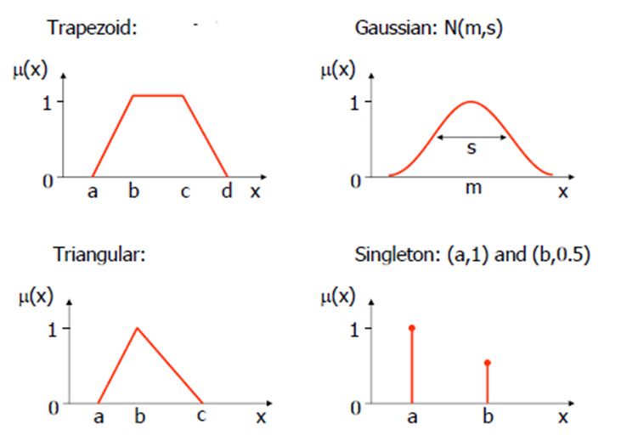


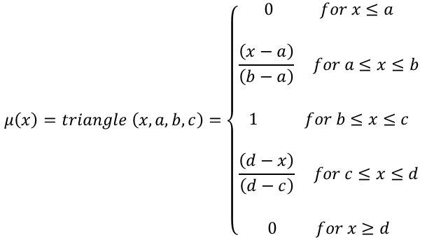
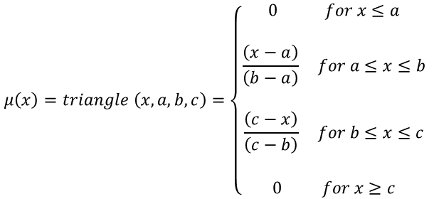
Case Study: Speed Control System
Step 4: Fuzzification (Convert crips inputs to fuzzy values)
$$μ\left(x\right)=triangle \left(x, a, b, c\right)=\left\{\begin{aligned}0 for x≤a \\ \\ \frac{\left(x−a\right)}{\left(b−a\right)} for a≤x≤b \\ \\ 1 for b≤x≤c \\ \\ \frac{\left(d−x\right)}{\left(d−c\right)} for c≤x≤d \\ \\ 0 for x≥d\end{aligned} \right.$$
Temperature[81°]
[81°]
$$μ\left(x\right)=triangle \left(x, a, b, c\right)=\left\{\begin{aligned}0 for x≤a \\ \\ \frac{\left(x−a\right)}{\left(b−a\right)} for a≤x≤b \\ \\ \frac{\left(c−x\right)}{\left(c−b\right)} for b≤x≤c \\ \\ 0 for x≥c\end{aligned} \right.$$
$\text{Warm}\text{[81°]}\text{=}\frac{90−81}{90−70}=0.45$
$$Hot\left[\text{81°}\right]=\frac{81−70}{90−70}0.55$$
7

Slide 8


Case Study: Speed Control System
Step 4: Fuzzification (Convert crips inputs to fuzzy values)
$$μ\left(x\right)=triangle \left(x, a, b, c\right)=\left\{\begin{aligned}0 for x≤a \\ \\ \frac{\left(x−a\right)}{\left(b−a\right)} for a≤x≤b \\ \\ 1 for b≤x≤c \\ \\ \frac{\left(d−x\right)}{\left(d−c\right)} for c≤x≤d \\ \\ 0 for x≥d\end{aligned} \right.$$
Cloud cover[23%]
[23%]
$$μ\left(x\right)=triangle \left(x, a, b, c\right)=\left\{\begin{aligned}0 for x≤a \\ \\ \frac{\left(x−a\right)}{\left(b−a\right)} for a≤x≤b \\ \\ \frac{\left(c−x\right)}{\left(c−b\right)} for b≤x≤c \\ \\ 0 for x≥c\end{aligned} \right.$$
$\text{Sunny}\text{[}\text{23\%}\text{]}\text{=}\frac{23−20}{40−20}=0.15$
$Partly Cloudy\left[23\%\right]=\frac{23−20}{50−20}=0.$1
8

Slide 9
Case Study: Speed Control System
Temperature[81°]; warm=0.45, hot=0.55
Step 5: Evaluate the rule
Rule 1: If it's Sunny and Cool, drive Fast
Sunny(Cover)ՈCool(Temp) » Fast(Speed)
Cloud cover[23%]; sunny=0.15, cloudy=0.1
Rule 2: If it's Sunny and Hot, drive Fast
Sunny(Cover) Ո Hot(Temp) » Fast(Speed)
0.15
0
0
0.15
0.55
0.15
Rule 3: If it's Cloudy and Warm, drive Slow
Cloudy(Cover) Ո Warm(Temp) » Slow(Speed)
0.1
0.45
0.1
Rule 4: If it's Cloudy and Cool, drive Slow
Cloudy(Cover) Ո Cool(Temp) » Slow(Speed)
0.1
0
0
9

Slide 10


Case Study: Speed Control System
Step 6: Defuzzification (Convert the fuzzy values to crips output)
$$Speed is 15\% slow and 10\% fast$$
Find centroids: Location where membership is 100%
Use formula weighted mean
$$Speed=\frac{\left(0+15\right)\left(75\right)+(0+10)(25)}{(75+25)}=13.75 mph$$
10

Slide 11
Conclusion
Building a fuzzy expert system is an iterative process that involves defining fuzzy sets and fuzzy rules, evaluating and then tuning the system to meet the specified requirements.
11

